Slide 1

Represented by:
Vennela Reddy-25MVCSMR0002
Lohitha Reddy-25MVCSMR0012
Meghana-25MVCSMR0027
Lakshmi Sri-25MVCSMR0093

Slide 2

Student Notes
Sharing Platform
Empowering students to upload and access curated subject notes seamlessly
BUILT FOR COLLABORATIVE EDUCATION
A MERN-based platform for collaborative education and knowledge sharing.
OUR TEAM
Ananya Sharma Full Stack Developer
Rohit Verma Backend Developer
Sneha Patel UI/UX Designer
Arjun Singh QA & Tester

Slide 3



The Challenge
Finding the right notes shouldn’t be this hard.
Students struggle to find organized, quality notes across subjects.
Wastes time and slows learning.
Hard to manage diverse data and ensure access for the right students.
Lack of a smooth, collaborative experience.

Slide 4

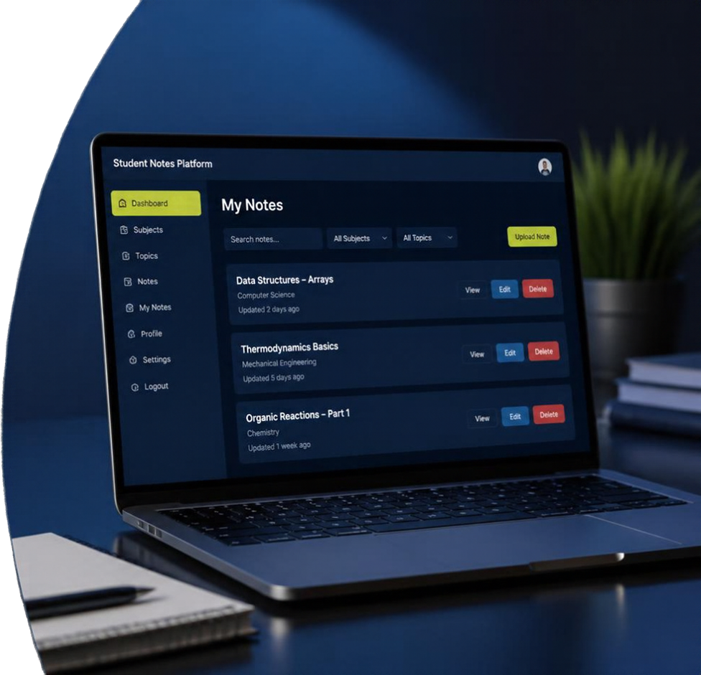

Our Innovation
A smarter way to manage and
share notes.
Full MERN stack platform for seamless
note management
Complete upload, view, update, and delete notes by subject and topic
Secure authentication with role-based permissions for students and admins
Intuitive React interface with a
responsive experience

Slide 5




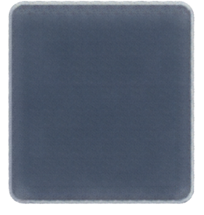

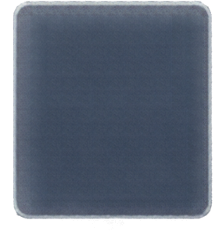





How It Works
A seamless journey from access to notes.
01
02
03
04
05
Choose
subject
Manage
notes
Process
requests
Store &
respond
Log in
Authentication
& role check
Select subject
and topic
Upload or access
notes with full
CRUD operations
REST APIs handle
requests and
business logic
MongoDB stores
data and system returns results
Frontend Update
React dynamically updates
the view for a smooth experience

Slide 6

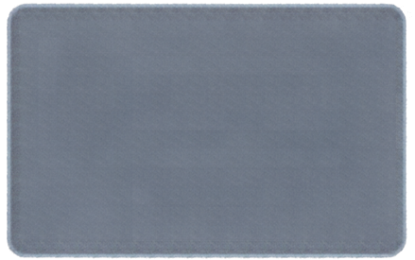
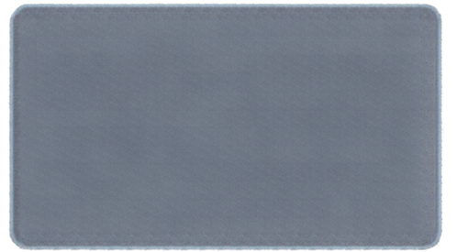










Technology & Algorithm
Modern stack. Smart design. Built for scale.
Express.js
+ Node.js
MongoDB
React.js
Flexible, scalable
data storage
RESTful API
backend
Dynamic, responsive
frontend
Secure by design
Optimized performance
Built to scale
Role-based access control implemented for security
CRUD operations optimized for
speed and reliability
MERN provides
full-stack JavaScript consistency
Scalable and easy
to maintain

Slide 7

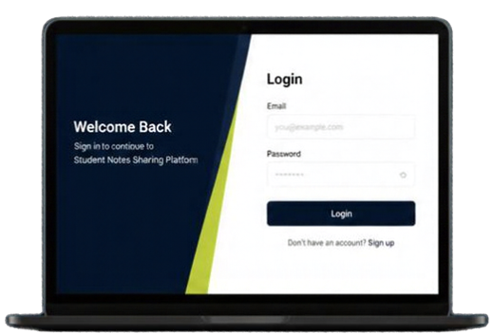
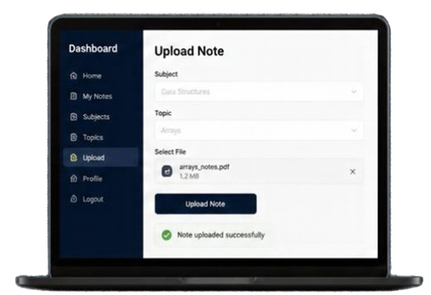
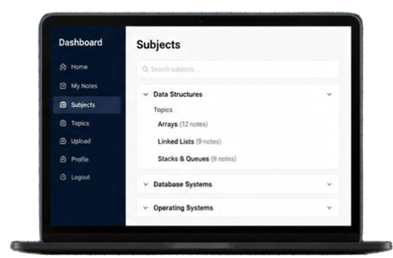



Demo & Impact
Login
Upload Notes
Browse Subjects & Topics
Secure and simple access for every student.
Easily upload and organize notes by subject and topic.
Quickly find and access notes organized the way you study.
Performance Highlights
Real Impact
Fast
Smooth
Improved
Enhanced
response times
navigation experience
note accessibility
student collaboration

Slide 8



Future Vision
We have a functional MVP
Core features working with secure access
We are building what’s next
Smarter search, mobile app, and LMS integration
Built to grow
Ready for more users and more subjects
Building a connected learning community, one note at a time.
Thank You
We welcome your questions and feedback.

